Slide 1
Introduction to eXo
the user experience platform-as-a-service company
Benjamin Mestrallet, Founder & CEO
February 2012

Slide 2
Agenda
Who We Are
Mission
Company overview
What Problem We Solve
Consumerization of IT
Defining the UXP and UXPaaS
Our Technology
Cloud-ready portal and UXPaaS: eXo Platform 3.5
Hosted solutions: eXo Cloud Services
Customer and Partner Success
Customer snapshots
Subscriptions, professional services and partner programs

Slide 3
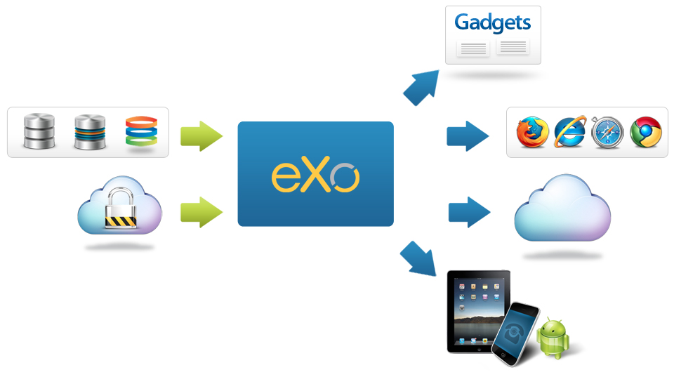
eXo Mission
Empower companies to deliver connected, collaborative user experiences to their employees, customers and developers, that can be securely deployed on-premises, mobile and cloud environments.

Slide 4
Quick Facts
Background
Founded in 2003; venture-backed since 2010
Headquarters: San Francisco (US), France (global)
Our Team
Veterans from JBoss, Red Hat, HP, Oracle, Hyperic, BCG
Cost-efficient distributed model; 175 employees worldwide (US, France, Ukraine, Vietnam, Tunisia)
What We Offer
Subscription model
Training and professional services
Core Competencies
Long Java history – implemented first portlet spec (JSR-168); led to first customer, US DoD
Open source foundation
Standards support (e.g. CMIS, JCR, portlets, OpenSocial)

Slide 5









Customers: Bank & Insurance

Slide 6












Customers: Government

Slide 7








Customers: Private Sector

Slide 8












Our Ecosystem: Value-Added Partners

Slide 9












Technology & OEM Partners

Slide 10
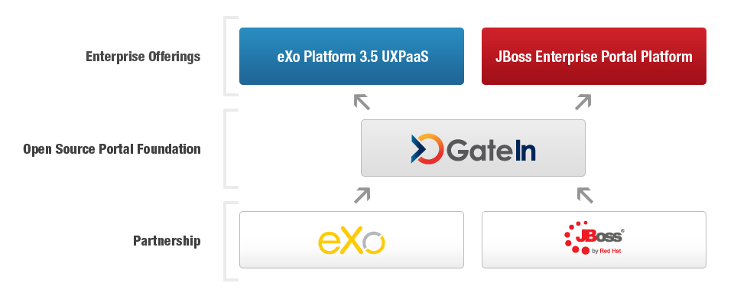
Red Hat Partnership

Slide 11
What Problem We Solve
Defining the UXP & UXPaaS

Slide 12
Evolution of the Enterprise Portal
Enterprise Portals: The Foundation for User Interaction
Provide a single, personalized user interface to access applications, information and business processes
Standards-based approach to user management and application integration
Converging Trends
Additional user interaction tools required for new scenarios (WCM, mashups, social software, etc.)
Cloud computing promises cost reductions and improved agility – organizations beginning to plan for and adopt
Focus on user engagement in the consumer web results in new style, functionalities, ease of use – and new expectations in the enterprise

Slide 13
New Requirements
Business Users
Demand for simplicity of Facebook-style interfaces and consumer web features for enterprise tools
Frustration with top-down resource allocation and dependence on IT
Enterprise Developers
Challenges of integrating third party apps with existing infrastructure
Multiple disconnected tools require different user interaction models and code bases
Longer development lifecycle hinders ability to deliver new solutions
IT Organizations
Disconnected silos are difficult to maintain; complex to add new users
End user adoption of third-party SaaS tools introduces new security concerns; loss of centralized control of enterprise information
IT becomes bottleneck to adopting new technology

Slide 14
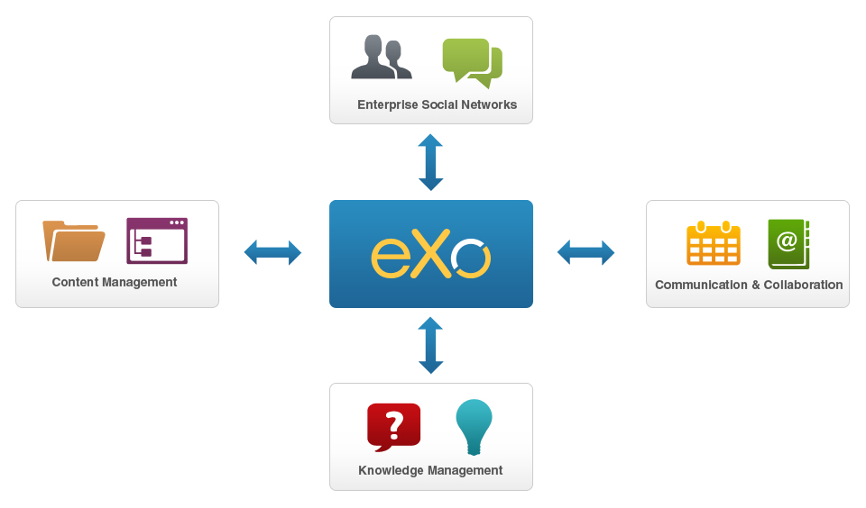
Beyond Portals: Introducing the UXP
A user experience platform (UXP) is a set of user interaction technologies – portal, content and knowledge management, social networks, and collaboration – delivered as a single, fully integrated product.

Slide 15
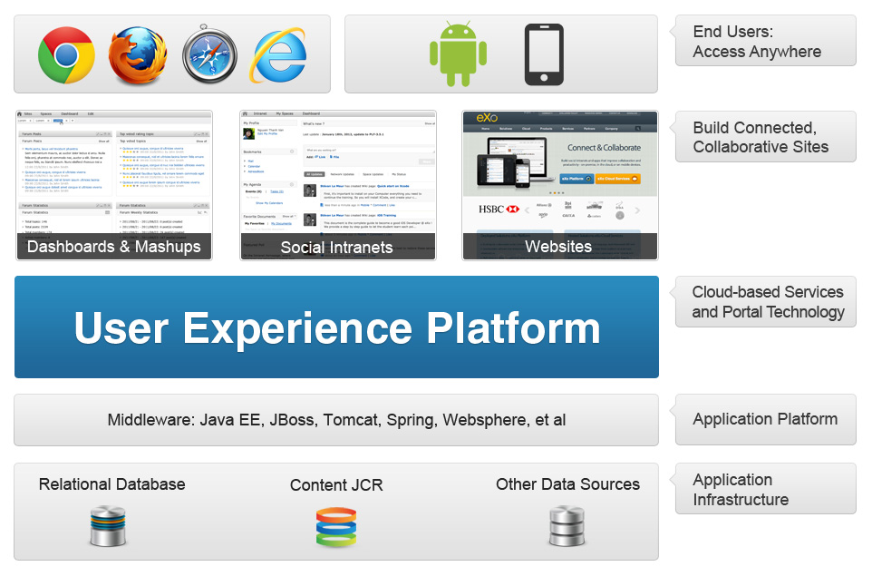
What Can You Create with a UXP?

Slide 16
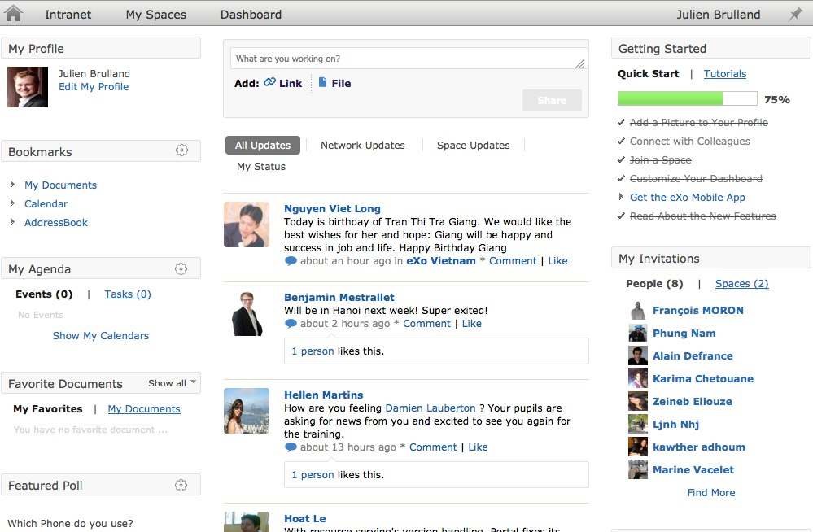
User-Friendly Social Intranets
Notes:
16
A common use case scenario for a UXP is building a social intranet. A secure enterprise intranet starts with a portal foundation, to integrate apps and content in a single dashboard for users; this dashboard view is customized based on what apps, content and information the user has permission to access.
A social intranet goes beyond a traditional portal to deliver a more interactive and productive user experience. Connect users and teams, activity streams, share calendars, documents and other resources, collaborate in group workspaces and much more.
A social intranet goes beyond a traditional portal to deliver a more interactive and productive user experience. Connect users and teams, activity streams, share calendars, documents and other resources, collaborate in group workspaces and much more.

Slide 17
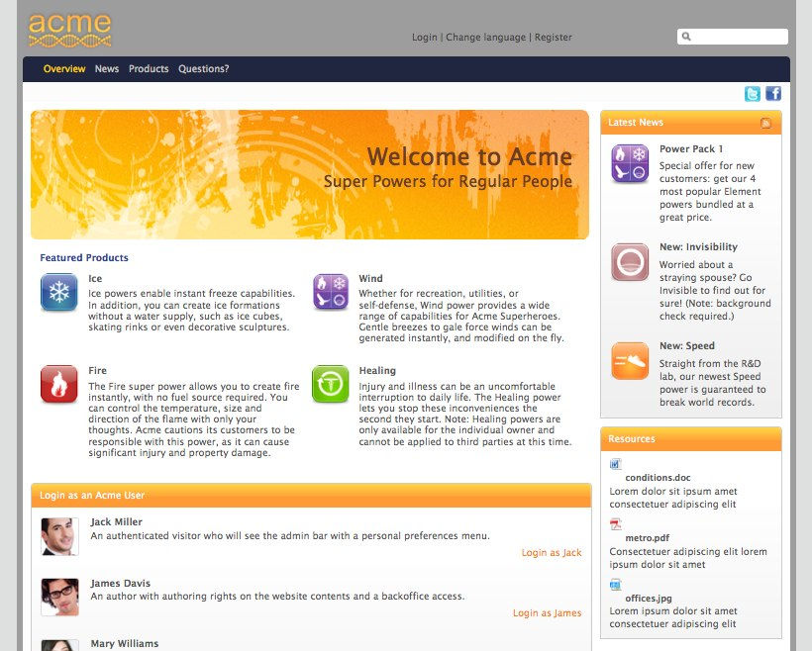
Modern Content-Based Sites
Notes:
17

Slide 18
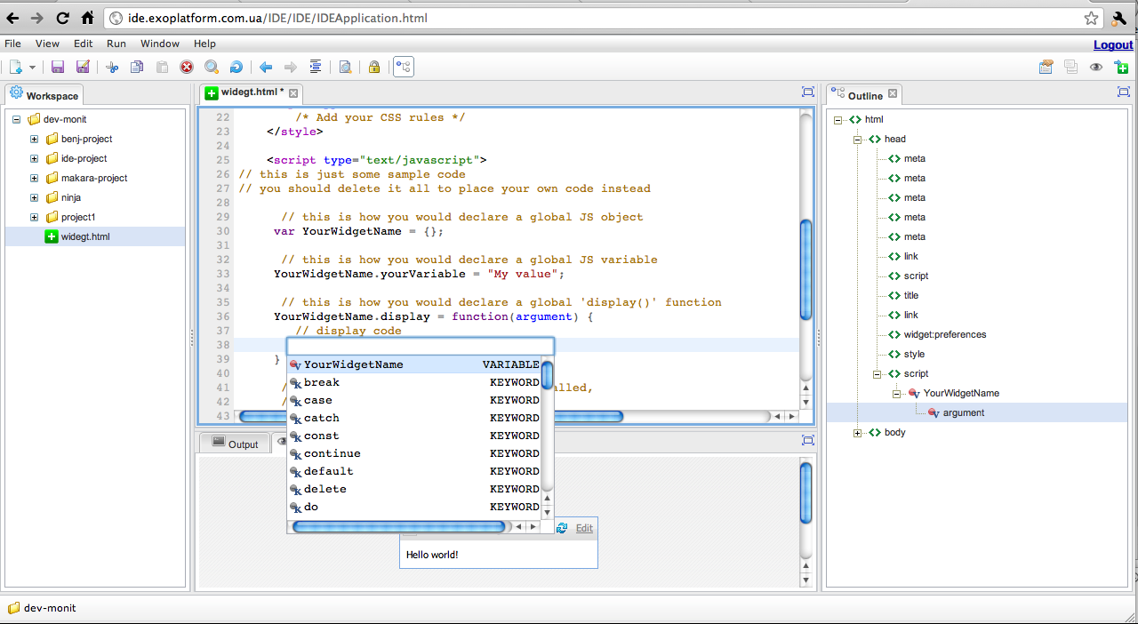
Custom Gadgets & Extensions

Slide 19
Defining the UXP
Integrated
A single set of user interaction technologies for many scenarios and devices
Flexible
Gadget development with built-in IDE; simplifies reuse of existing and third-party apps
Customizable dashboards
Social & Collaborative
Social intranets, customer and partner extranets, transactional websites
Mobile

Slide 20
The UXPaaS: A Cloud-Ready UXP
Cloud-Enabled
Support for multi-tenancy for deployment to public and private clouds
A UXP that can be delivered as a service by cloud providers
Automation & Elasticity
JVM resource self-management – easily scale up or down
Ease of provisioning with little IT administration overhead
Secure
Ensure the isolation and integrity of individual client portals
Ability to integrate with existing client directory systems
Manageable
Centralized & secure for IT management
Elasticity and self-provisioning services
Easily manage and meter use of tenants

Slide 21
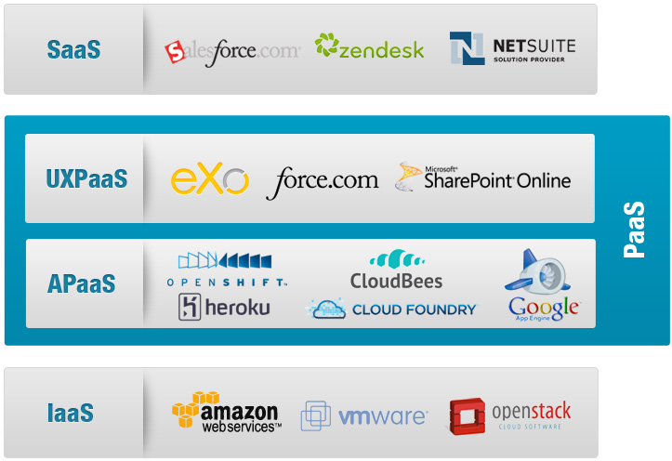
The UXPaaS & The Cloud Market

Slide 22
eXo Platform 3.5
the mobile and cloud-ready portal and user experience platform

Slide 23
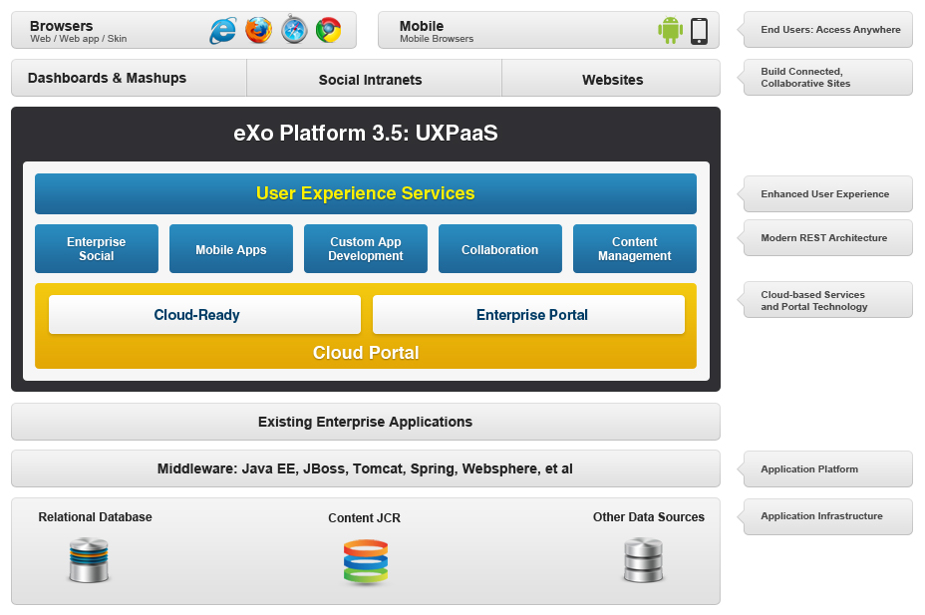
Introducing eXo Platform 3.5 UXPaaS

Slide 24
Features & Benefits
Portal & Content Management Foundation
Securely integrate with an existing user directory
Integrated content management (ECM: WCM, DMS, workflows)
Enterprise Social Networks
Create rich profiles; find and connect with colleagues
Activity streams
Collaboration & Knowledge Management
Collaborate in group workspaces
Built-in productivity tools: wiki, forums, FAQs, calendars, documents…
The Platform Difference
Customize
Extend
Notes:
Details:
- ECM Features:
- Create, edit & publish web content
- Capture, store and manage documents
- Optional BPM and workflow features
- WCM Improvements for 3.5:
- Edit inline (on the front-end) and publish in one click
- SEO: Search Engine Optimization
- New File Explorer Design
Enterprise Social features:
- Create and connect rich user and team profiles
- Follow activity streams of users, teams, applications, processes
- Workspaces for users and groups
- OpenSocial gadgets
-- Improvements in 3.5 include: New Activity Stream Page with Filters, User Directory is simplified, New Space Layout
Collaboration & Knowledge Management features
-- An intranet or extranet that aims to connect a community of users, partners or customers will likely require a forum and/or wiki. eXo Platform 3.5 includes out-of-the-box features to easily add an enterprise wiki, forum, FAQ’s, and Answers to your sites.
-- Enterprise Wiki: Permissions integrated with eXo Platform user management; Social Network Integration ( Activity Stream, Space, …);Pages are stored inside eXo JCR – our centralized content repository; Page Management, search & versionning; Easily add pages: Wysiwyg editor & support for multiple syntaxes
-- Group calendars
Calendars can be shared between users and teams
Improvements to PLF 3.5: Remote Calendar
Integrate 3rd Party Calendar into eXo Calendar
Based on Standard CalDAV, Ical
Apps: Google Calendar, MS Exchange, …
Warning: Read Only
You can view all your calendars in eXo but cannot update them

Slide 25
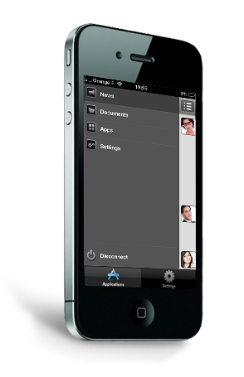
Native Mobile Apps
Native mobile apps for iPhone, iPad and Android give eXo Platform 3.5 users secure access to their intranet dashboards, including documents and custom gadgets.
Notes:
Native Application to Access Intranet Services
Native Application : iOS (iPhone, iPad), Android
Social Network (activities), Documents, Gadgets
Integrates with eXo Platform 3.5 Enterprise Edition
Interesting Blog post « Introducing New Mobile Applications for eXo Platform 3.5 »
Note: We can also build mobile websites with eXo Platform’s content management features
Based on HTML/CSS programming

Slide 26
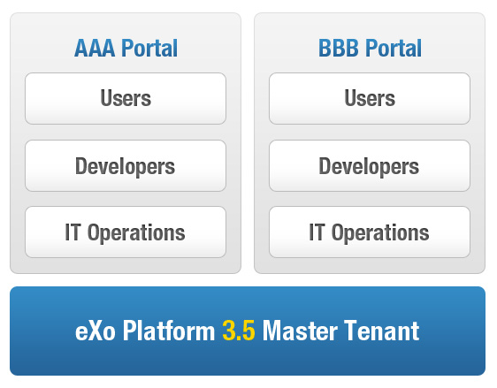
The First Multi-Tenant Portal & UXP
Cloud: Introducing the UXPaaS
Private or public cloud deployments
Elastic solution

Slide 27
Benefits of Cloud Deployments
CLOUD PROVIDER
Cost efficient portal multi-tenancy (JVM level)
One extensible and unified user experience platform to operate across many customers
USERS
Enterprise social and collaboration capabilities
Embed business apps in customized dashboards
Extend your portal by aggregating private / public cloud apps
Smartphone & tablet User Interface
IT OPS
Private/public cloud management and monitoring within a portal
Single UX for all users lowers support costs

Slide 28
eXo Cloud Services
Hosted Solutions

Slide 29
eXo Cloud Services
Build your own cloud with eXo Platform 3.5 UXPaaS
Cloud-enabled infrastructure provides ideal foundation for building a public or private cloud offering
Or connect and collaborate in a hosted solution: eXo Cloud Services
Social intranets
Collaborative development environments

Slide 30
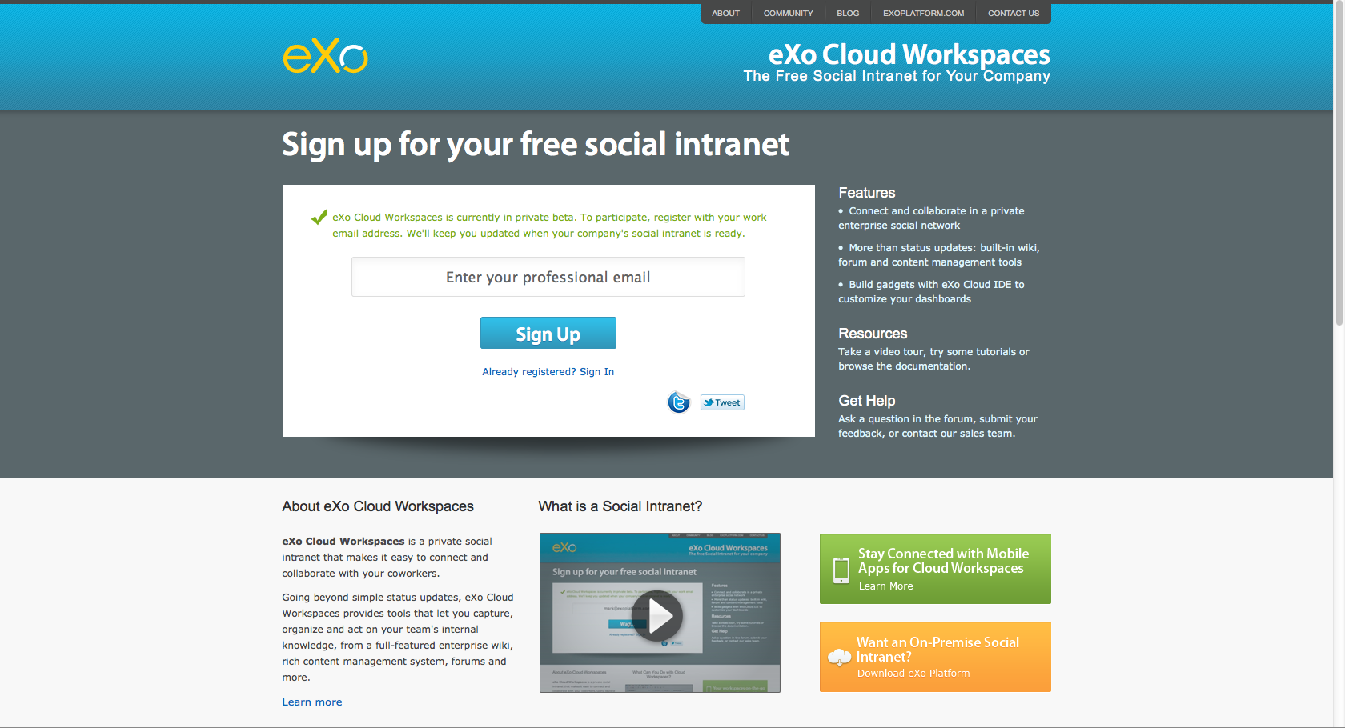
eXo Cloud Workspaces
Notes:
30

Slide 31
eXo Cloud Workspaces
Private Enterprise Social Network in the Cloud
www.cloud-workspaces.com
Currently in private beta
Social Intranet and Document Collaboration
Secure, organized file sharing and document management system
Team calendar, forum, wiki and other built-in apps
Share ideas, feedback and updates in activity streams
Mobile Apps
Access your documents and dashboards via native mobile apps
Customizable Experience
Users: drag-and drop widgets into personalized dashboards
Developers: build custom extensions with embedded IDE

Slide 32
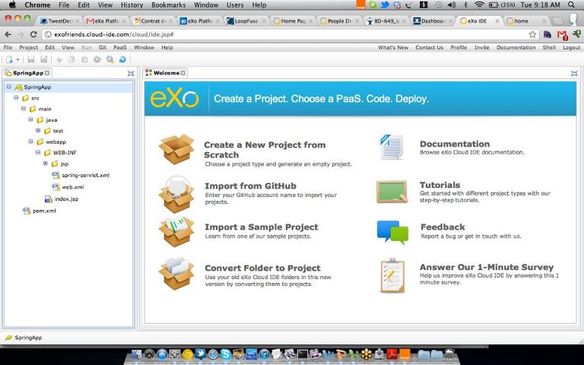
eXo Cloud IDE
Notes:
32

Slide 33
eXo Cloud IDE
Hosted Development-as-a-Service
www.cloud-ide.com
A complete desktop IDE in the cloud; no loss of ergonomics or performance
Collaborative Development
Develop REST services, gadgets, HTML5 and content apps
Multi-language, multi-framework; focus on Java & Spring but also supporting PHP, Ruby, Groovy, GWT and more
PaaS Deployment
PaaS deployment via Git push and/or WAR deployment
Support for: CloudBees, Heroku, Red Hat OpenShift, Cloud Foundry
Native Git integration; built-in command menu

Slide 34
Customer
Success Stories

Slide 35

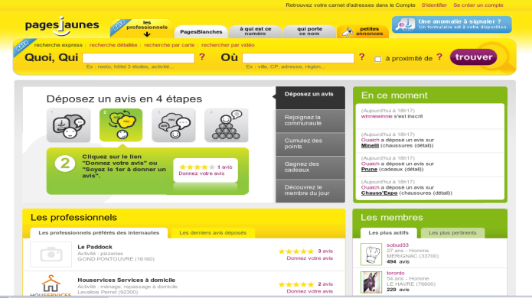
Pages Jaunes - Publishing
Company
France's leading business website developer & publisher of printed and online directories (Yellow Pages)
6th largest worldwide internet advertising revenue platform (500 Million Euros in 2009)
Requirements
Back office portal to manage:
Content (pushed on Apache server when published)
Applications (for customers/partners/users) as portlets
Competition
Liferay + OpenCMS
Partner
Groupe Open (SI)
Why eXo?
Single platform for content & apps
Standard-based (JCR, portlets, gadgets, xCMIS…)

Slide 36

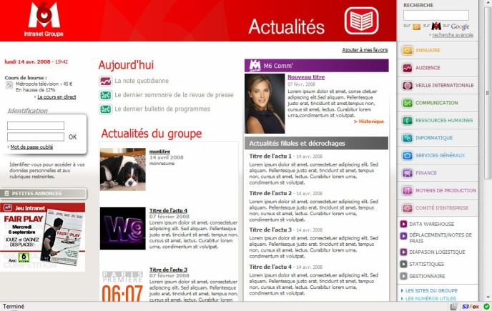
M6 – TV Media
Company
France-based audiovisual company specializing in the production, distribution and marketing of television programs
2009 revenue of 1.4 Billion Euros
Requirements
Create the next generation of M6 intranet
Offer a true collaboration platform for 3,000 users to share and exchange
Competition
EMC Documentum + BEA Weblogic
Partner
Business&Decision
Why eXo?
Flexibility to easily customize and add features
Lower cost and higher ROI

Slide 37

Generali - Insurance
Company
European leader in insurance sector
Generali France = 14 Billion Euros revenue
Requirements
Update homegrown sales management extranet without losing legacy content
Competition
IBM WebSphere
Partner
Bull France (provides L1 support)
Why eXo?
Broad support of standards and technologies
Ability to reuse existing content and deploy a new extranet for the sales team in only a few months

Slide 38
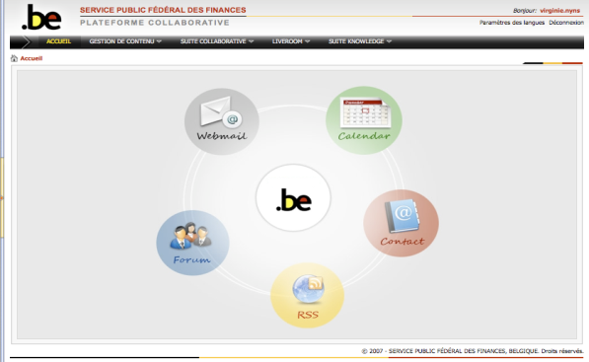
Belgium Ministry of Finance - Public
Organization
Ministry of Finance needed to eliminate information silos with departments using many different software solutions (SharePoint, FileNet…)
Requirements
Build a centralized system for collaboration that could be managed by its own IT department
Standardize on a rich portal platform with collaboration tools to connect up to 30,000 intended users
Competition
Bid process with many large software vendors
Partner
Bull Belgium (SI, Support and Dev.)
Why eXo?
Improved productivity, communication and knowledge sharing
Integrated email, calendaring, document management, and contact management solution

Slide 39
Our Business Model
Subscriptions & Professional Services

Slide 40
Subscription Benefits
Certified Production-Ready Software
Multi-year support and update policies
Includes features not available in community project
Access to all supported versions
Documentation & Knowledge Base
Maintenance Program
Delivering certified updates, patches and bug fixes
Access and support for new versions released
Enterprise Class Support
Unlimited incidents
Coverage up to 24*7 with 1 hour response time‏

Slide 41
Subscription Editions
 | eXo PLATFORM EXPRESS | eXo PLATFORM PROFESSIONAL
Enterprise Portal
Content Management (ECM, WCM, DMS)
Development Tools (IDE, JCR and more)
Social Networks
Knowledge Management
Collaboration & Mobile Apps
Cloud Ready

Slide 42
Subscription SLA
 | STANDARD | PREMIUM
Certified production-ready software
Maintenance program
New versions released during the subscription lifetime
Enterprise support | Business Hours | 24/7
Documentation & knowledge base

Slide 43
Selecting the Right Subscription
Subscription TYPE | TERM | SLA | PRICE | SELECT
EXPRESS EDITION
eXo Platform 3.5 - EXPRESS – Standard 8 Cores | 1 Year | Standard | 22 500 $ | ☐
eXo Platform 3.5- EXPRESS - Standard 16 Cores | 1 Year | Standard | 35 500 $ | ☐
eXo Platform 3.5 - EXPRESS – Standard 64 Cores | 1 Year | Standard | 108 000 $ | ☐
eXo Platform 3.5 - EXPRESS – Standard 8 Cores | 3 Years | Standard | 57 375 $ | ✓
eXo Platform 3.5- EXPRESS - Standard 16 Cores | 3 Years | Standard | 90 525 $ | ☐
eXo Platform 3.5 - EXPRESS – Standard 64 Cores | 3 Years | Standard | 275 400 $ | ☐
PROFESSIONAL EDITION
eXo Platform 3.5 - PROFESSIONAL – Standard - 8 Cores | 1 Year | Premium | 1 Year | ☐
eXo Platform 3.5 - PROFESSIONAL – Standard - 8 Cores | 1 Year | Premium | 1 Year | ☐
eXo Platform 3.5 - PROFESSIONAL – Standard - 8 Cores | 1 Year | Premium | 1 Year | ☐

Slide 44
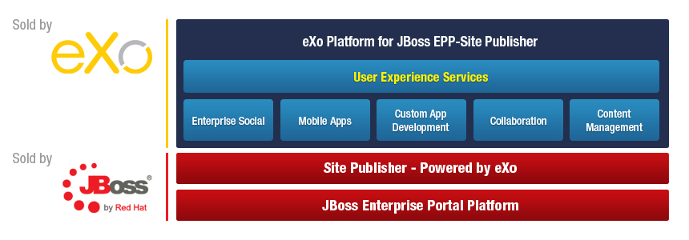
eXo Platform for JBoss

Slide 45
eXo Developer Subscription
 | STANDARD | PREMIUM
Access to eXo Platform | Up to 5 developers | Up to 10 developers
Developer support services | 20 cases | 50 cases
Developer documentation and knowledge base
Response time | 2 business Days | 1 business Day
Maintenance program
Dedicated contact within eXo
Pricing starts at: | 7 500 € | 18 500€

Slide 46
eXo TAM Subscription
 | TECHNICAL ACCOUNT MANAGER*
Designated contact within eXo support team
Proactive support
Onsite visits | 4 / year
Response time | Business Hours
Unlimited tickets
Pricing | Upon request
* An active eXo Platform subscription is required

Slide 47
eXo Professional Services
Evaluation Programs
Quick Start Program
Development Subscription
Training
Curriculum designed for admins, developers & architects
Certification
Consulting
POCs
Custom solutions
Migration
Notes:
47

Slide 48
Quick Start Program
Access to eXo Platform | 3 months License
Developer support services | 10 cases
Developer documentation and knowledge base
Response time | 2 business Days
Maintenance program
Dedicated eXo training | 4 hours Webinar training
3 900€
* The entire program fee will be deducted from the purchase of an annual subscription

Slide 49
eXo Training & Certification
 | eXo FUNDAMENTALS (2 DAYS) | eXo DEVELOPER (3 DAYS) | eXo ARCHITECT (2 DAYS)
Course Objectives | Introduce the key benefits and features of eXo products | Customize eXo to support POCs & deployments | Manage, support & maintain eXo in production
Student Profile | Users, consultants, project managers, portal administrators, webmasters | System engineers with >1 year Java experience | System engineers with >4 years of Java experience
Prerequisite | - | eXo Fundamentals | eXo Developer
Public | 1,500.00 € | 1,900.00 € | 1,900.00 €
On-site (8 participants) | 5,000.00 € (plus T&L) | 6,500.00 € (plus T&L) | 6,500.00 € (plus T&L)
Notes:
49

Slide 50
eXo SI Partner Program
Benefit Highlights | SILVER | GOLD | PLATINUM
SUPPORT, TRAINING & CERTIFICATION
Named support contacts | 4 | 5 | 8
Support services (number of cases) | 15 | 20 | 30
Support SLA (business days) | 2 days | 1 day | 1 day
eXo Fundamentals / Developer / Architect (# seats included) | 4 / 3 / - | 6 / 3 / 2 | 8 / 4 / 3
Marketing & Sales
Visibility and promotion: website, newsletter, collateral, events, joint PR | Yes | Yes | Yes
Enterprise Subscription reseller & 1st line support royalty | Contact Us | Contact Us | Contact Us
Sales enablement and pre-sales support | Yes | Yes | Yes
Lead sharing programs; program renewal discount | Yes | Yes | Yes
Partner Requirements
Comply with eXo Partner Program contract terms | Yes | Yes | Yes
Notes:
Everything you need to get started quickly and deliver high-value projects to your customers:
Developer subscription & support
Training & Certification included
Royalties & Lead program
Sales & Technical support

Slide 51
eXo Reseller Program
BENEFIT Highlights | Authorized | Premier
SUPPORT, TRAINING & CERTIFICATION
Named support contacts | - | 1
Support services | - | 5 cases
Support SLA | - | 2 business days
eXo Fundamentals (# seats included) | - | 1
Discount on eXo Training & Certification courses | 7% | 10%
MARKETING & SALES
Visibility and promotion: website, newsletter, collateral, events, joint PR | Yes | Yes
Sales enablement & pre-sales support | Yes | Yes
Royalties for Enterprise Subscription opportunities | Contact Us | Contact Us
PARTNER REQUIREMENTS
Comply with eXo Partner Program contract terms | Yes | Yes

Slide 52
Thank You
Questions?
Contact us: sales@exoplatform.com

Slide 53
Appendix 1
Detailed Features & Screenshots

Slide 54
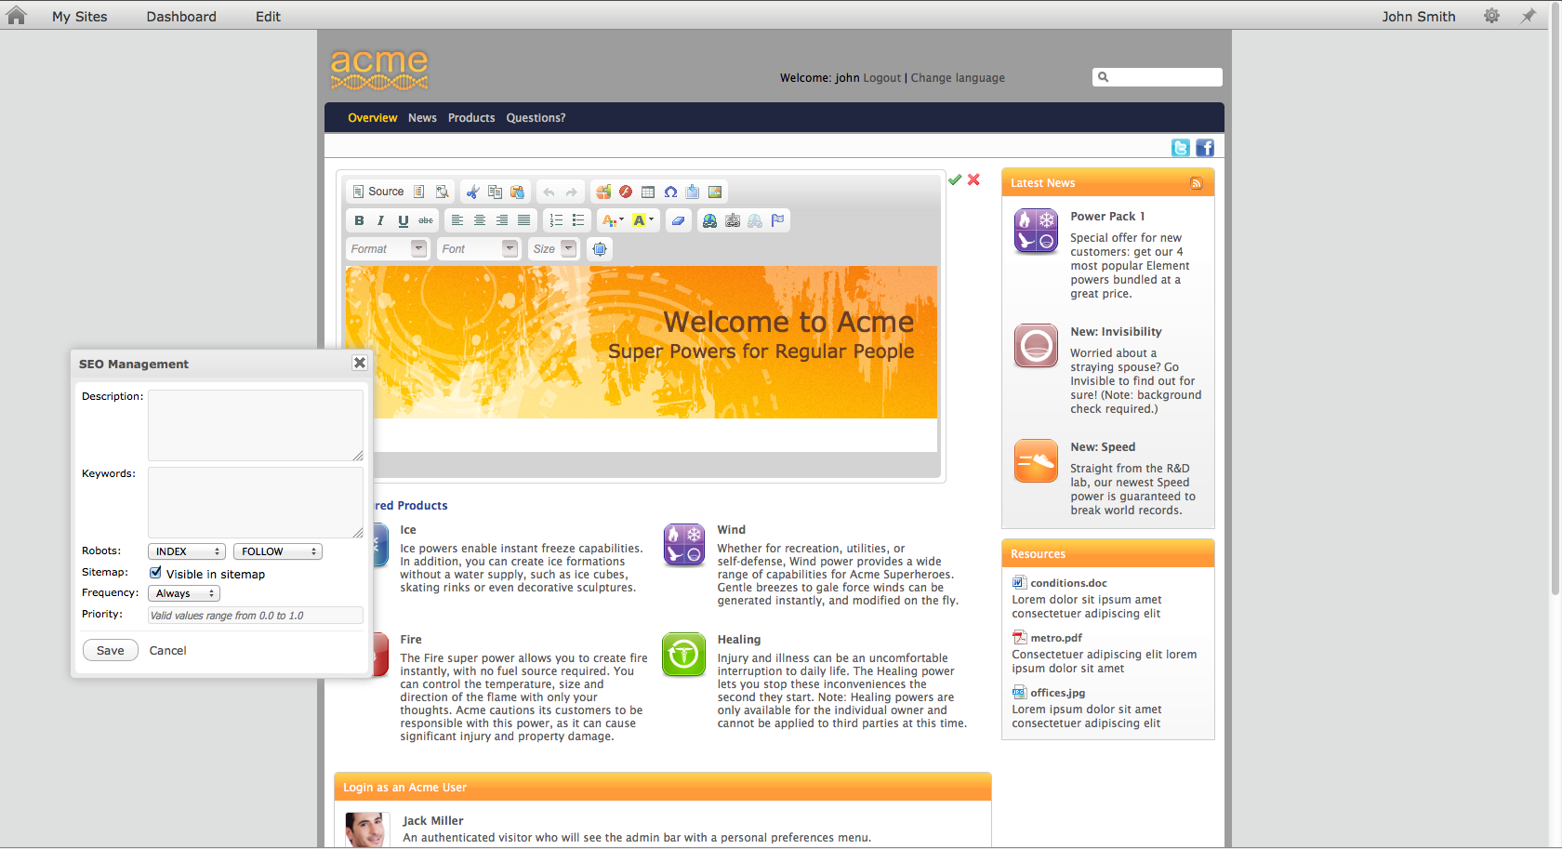
UXP Features: Content Management
Confidential – Internal Use Only
Notes:
54
ECM Features:
Create, edit & publish web content
Capture, store and manage documents
Optional BPM and workflow features
WCM Improvements for 3.5:
Edit inline (on the front-end) and publish in one click
SEO: Search Engine Optimization
New File Explorer Design

Slide 55
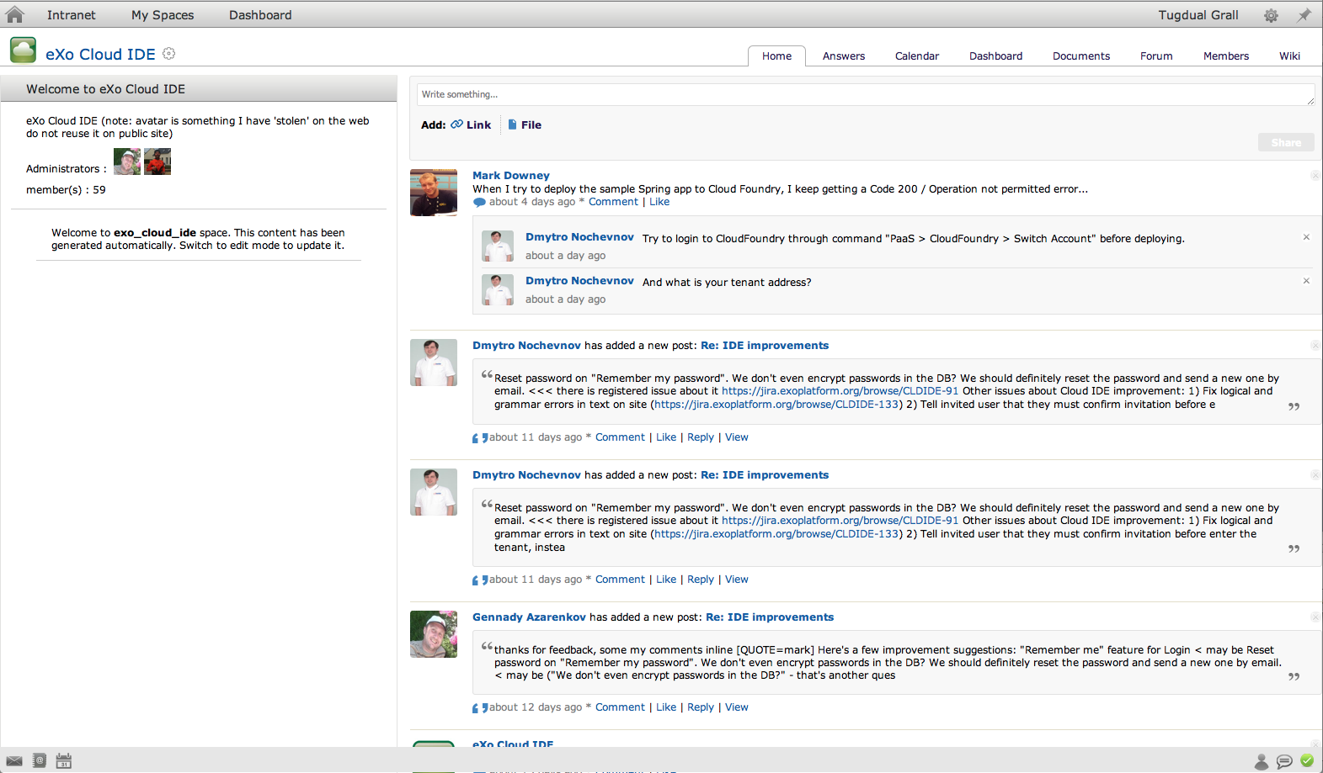
Enterprise Social Networks
Confidential – Internal Use Only
Notes:
55
Features/benefits:
Create and connect rich user and team profiles
Follow activity streams of users, teams, applications, processes
Workspaces for users and groups
OpenSocial gadgets
PLF 3.5 improvements:
New Activity Stream Page with Filters
User Directory is simplified
New Space Layout

Slide 56
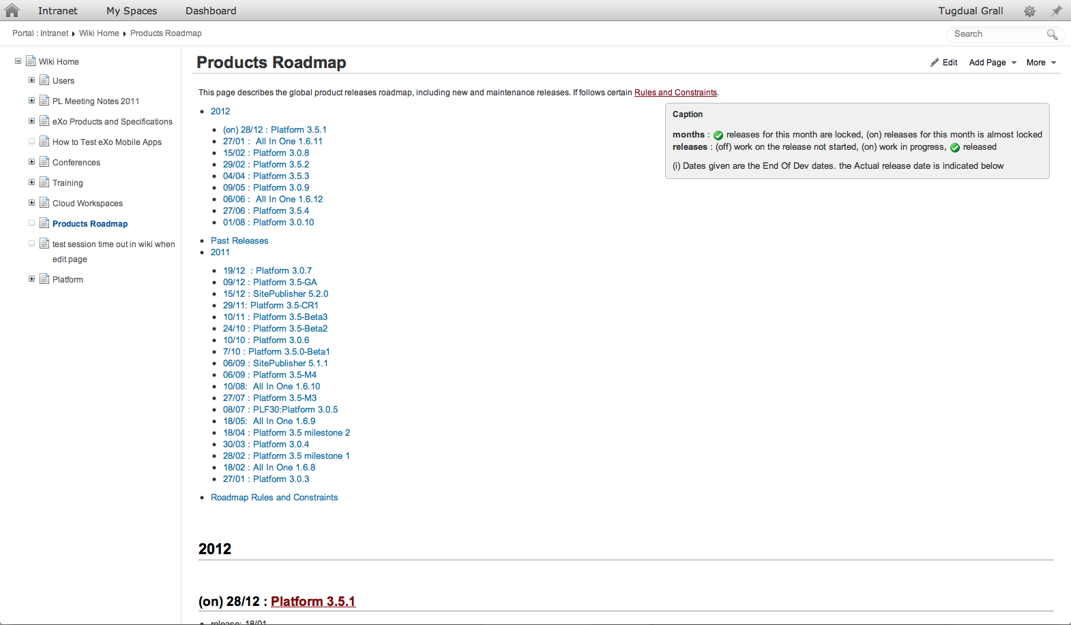
Knowledge Management: Wiki & Forum
Confidential – Internal Use Only
Notes:
56
An intranet or extranet that aims to connect a community of users, partners or customers will likely require a forum and/or wiki. eXo Platform 3.5 includes out-of-the-box features to easily add an enterprise wiki, forum, FAQ’s, and Answers to your sites.
Enterprise Wiki
Permissions integrated with eXo Platform user management
Social Network Integration ( Activity Stream, Space, …)
Pages are stored inside eXo JCR – our centralized content repository
Page Management, search & versionning
Easily add pages: Wysiwyg editor & support for multiple syntaxes
Forums, FAQs, Answers

Slide 57
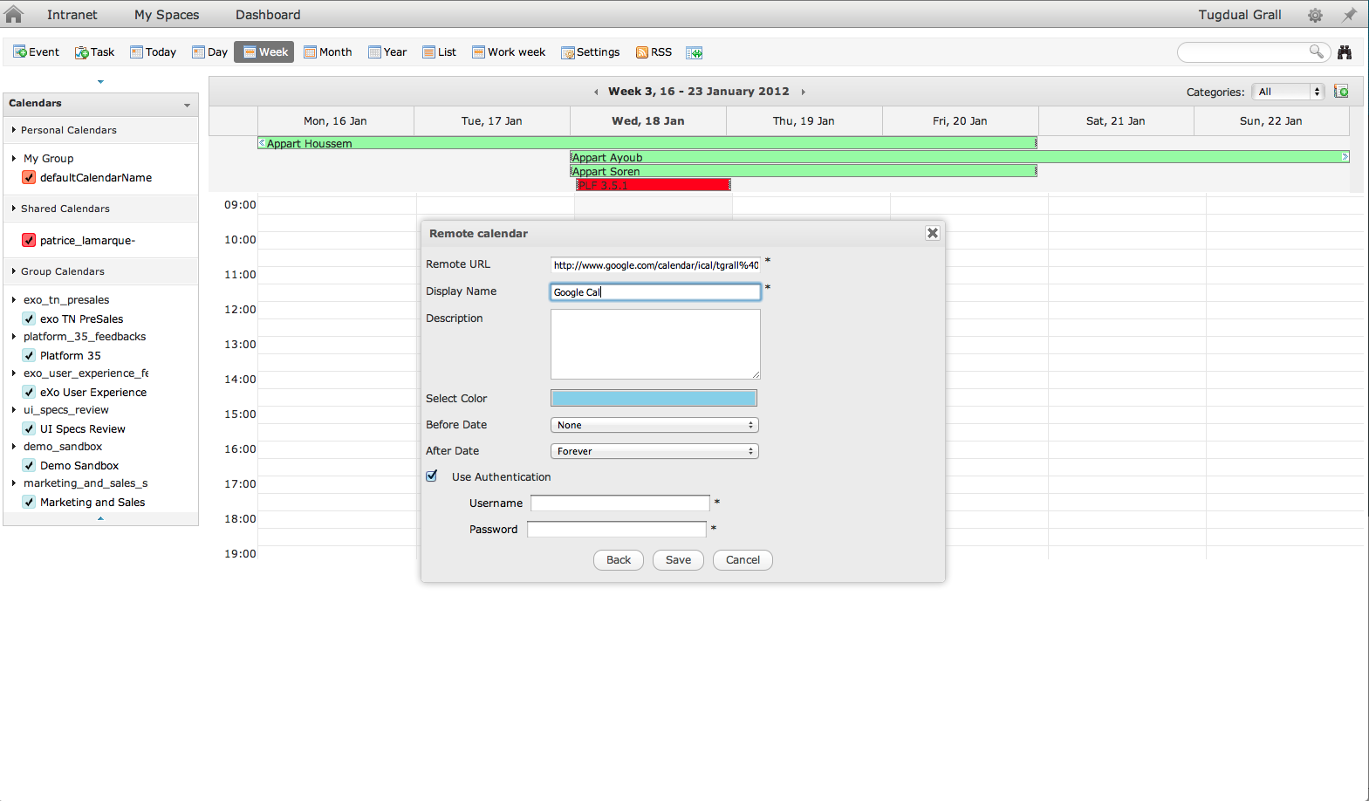
Collaborative Calendars
Confidential – Internal Use Only
Notes:
57
Calendars can be shared between users and teams
Improvements to PLF 3.5: Remote Calendar
Integrate 3rd Party Calendar into eXo Calendar
Based on Standard CalDAV, Ical
Apps: Google Calendar, MS Exchange, …
Warning: Read Only
You can view all your calendars in eXo but cannot update them

Slide 58
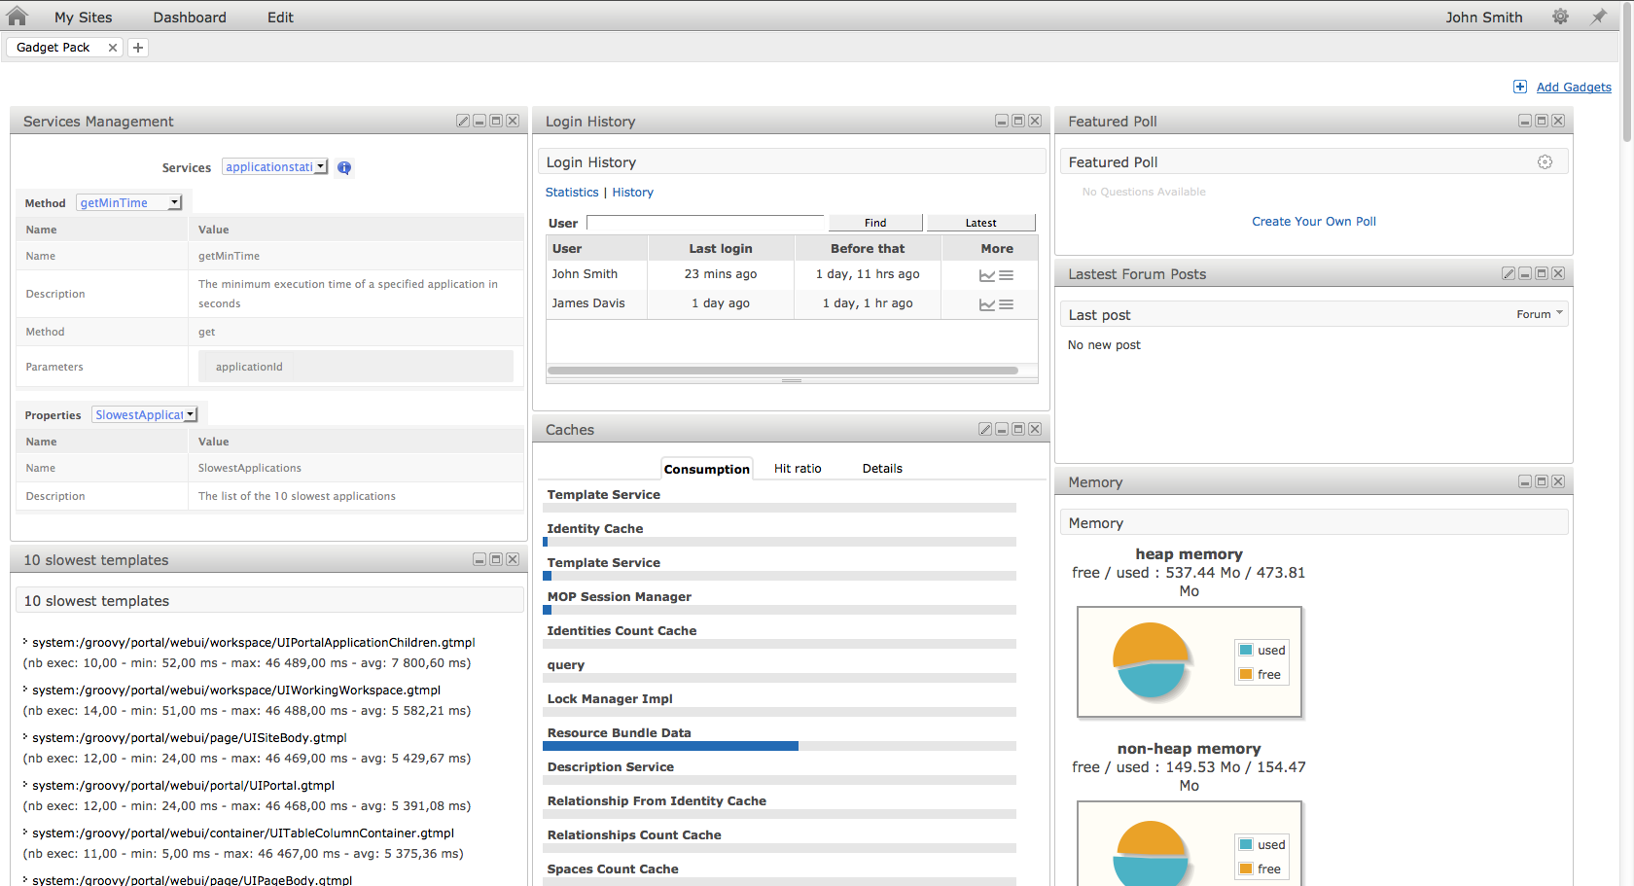
Extensible: Gadget Pack
Confidential – Internal Use Only
Notes:
58
Drag and drop gadgets to create personalized dashboards

Slide 59
Extensible: Gadget Pack
Gadget Pack for eXo Platform 3.5 Enterprise Edition
Developers can quickly learn eXo APIs to build new functionality for end users
Engagement Gadgets
Latest Forum Posts
Top Voted Topics
Forum Statistics
Who’s Online?
Latest Wiki Updates
Friend Suggestions
Featured Poll
Audit Gadgets
User Login History
Page Activity Stats
User Activity Audit
Collaboration Gadgets
Calendar
Publish Content
Text Translation
Management & Monitoring Gadgets
Memory Charts
Cache Levels
Applications Statistics
10 Slowest Templates
All Template Statistics
Services Management
Groovy Console
Notes:
59

Slide 60
Why a Web IDE?
A complete desktop IDE, now in the cloud
No loss of ergonomics or performance
Mashup development
Wiring REST Services, Gadgets, HTML5 and structured content
Quick test in IDE with no deployment overhead
Collaborative editor
Social coding
Wiki and forum integration
Centralized administration
No setup, available on all computers
Simple upgrades

Slide 61
COMMUNITY VS ENTERPRISE
eXo PLATFORM: COMMUNITY Use eXo Platform 3.5 Community Edition if you are ready to: | eXo PLATFORM: ENTERPRISE With eXo Platform 3.5 Enterprise Edition, you get:
Resolve issues and bugs during development. Rely exclusively on the community for answers to questions. Identify and resolve security issues on your own. Support the software on your own without any SLA. Forego access to certain features, such as mobile apps or cloud support. | Enterprise-quality support during development and/or production with guaranteed SLAs. An integrated package, tested and certified on multiple JVMs and Operating Systems. Additional functionality, including native mobile apps and cloud-ready features. Continuous updates and patches to resolve security, performance, and stability issues. Notifications about security issues and advice on how to resolve them.
Notes:
61

Slide 62
Appendix 2
Reusable Elements (for Training & Creating New Technical Content)

Slide 63
eXo cloud stack
HTTP
requests
eXo Cloud Runtine
Verticalized Platform as a Service
Elasticity (for tenants and apps within tenants)
Pause/Resume of tenants in less than 10 sec
High tenant density (280 active tenants on an Amazon instance)
Promote an unique development Framwork
Chromattic (JCR), JAX-RS and HTML5/Gadgets
See it as a VBA like PaaS
To be released in 2012 under cloud-runtime.com name
Cloud-ide.com already runs on it on an average of 2 servers for more than 6000 tenants
Cloud-admin
tenant creation requests
HAProxy
configure
Tenant removing
Statistic
Tenant creation
AS1
AS2
ASn
Cloud-agent
Cloud-agent
Cloud-agent
...
Other applications
Other applications
Other applications
Databases

Slide 64

Multi-Tenant Architecture
VM
XXX Portal
YYY Portal
VM
Users
Users
Public Cloud
Developers
Developers
IT Operations
IT Operations
VM
VM
eXo Platform 3.5 Master Tenant
(will run on any Java PaaS)
VM
VM
Private Cloud

Slide 65
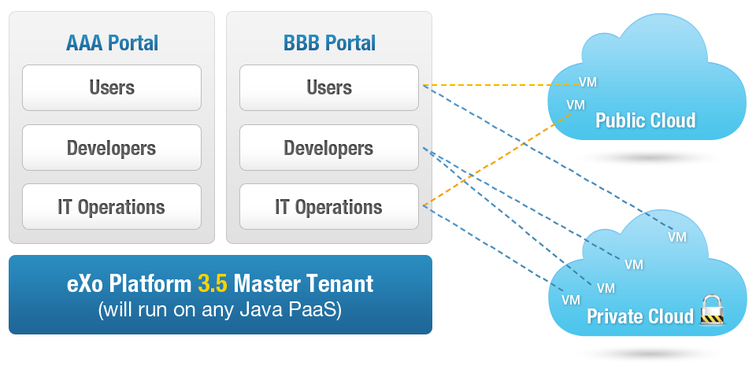
The First Multi-Tenant Portal & UXP
Notes:
Add to left of diagram after removing clouds:
Cloud: Introducing the UXPaaS
Private or public cloud deployment
Elastic solution

Slide 66
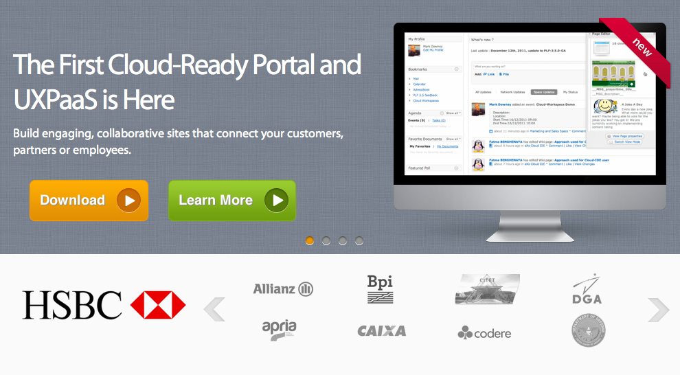
Screenshots #1
Text description of the a specific area
Text description of the a specific area

Slide 67
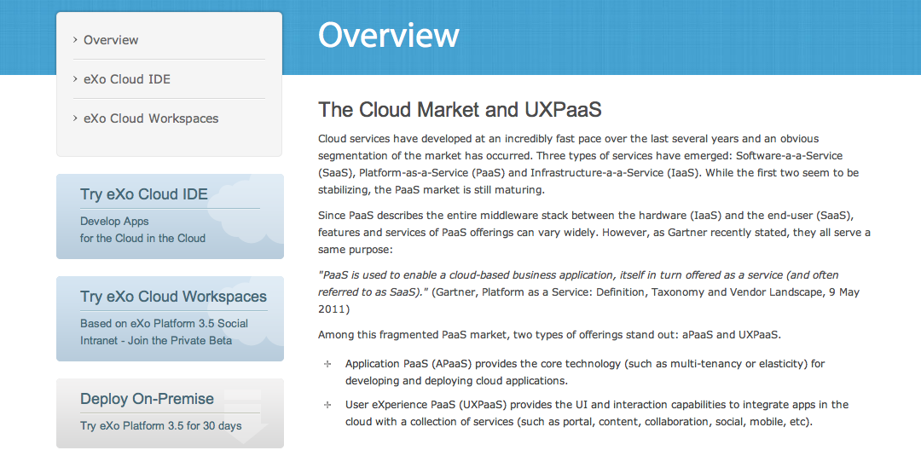
Screenshots #2 (light images*)
Text description of the a specific area
Text description of the a specific area
*IF THE SCREENSHOT IS LIGHT, USE BLACK LINES

Slide 68
Screenshots #3 – Numbers
1
Text description of the a specific area
1
2
Text description of the a specific area
2
3
Text description of the a specific area
3

Slide 69
Screenshots #4 (light images*) – Numbers
1
Text description of the a specific area
1
2
2
Text description of the a specific area
3
Text description of the a specific area
3
*IF THE SCREENSHOT IS LIGHT, USE BLACK NUMBERS

Slide 70
Template Guide
how to use eXo PPT

Slide 71
Fonts & Other Rules
Title Page Title: Font Arial // Size 36pt // Color Black
Title Page Subtitle: FONT ARIAL // SIZE 20 PT // COLOR R:124 G:124 B:124 // ALL CAPS* // INTERLETTER SPACING 3PT
Slide Title: FONT ARIAL BOLD // SIZE 24PT // ALL CAPS* // INTERLETTER SPACING 3PT // COLOR R:186 G:186 B:186
Never use all caps for the word “eXo”
!
!

Slide 72
Fonts & Other Rules
First bullet text: Arial, Bold, 20pt size
All other text below is Arial 18pt, color dark gray
To highlight important text within a section, you can use the theme yellow color (same as bullet point colors) selected text: R:247 / G:193 / B:46

Slide 73
Other Elements

Slide 74
TITLE
TEXT SHOULD NOT GO OVER THOSE LINES
CONTENT

